Slide 1
Boosting sales margin of a product using price optimization for E-commerce platform
B-565 Data mining

Slide 2



About Team
Gauri Chaudhari Divya Manoj Pooja Parab

Slide 3
What is price optimization?
Price optimization technique mainly solves two major problem:
Understanding the customers behavior for different pricing strategies and determine the optimal price of the product
Accounting different features of the product and obtain price by linear regression.
We considered sales as a major price optimization factor to determine best price.

Slide 4
How did we get the data?
About: Brazilian E-commerce public dataset of Olist store.
Records: 100k
Features: 40
Time Frame: 2016 – 2018
Data consolidation (8 files): customers, order-items, order payment, order reviews, orders, product, sellers, product category translation name.
File Format: CSV
Original Dataset Link: https://www.kaggle.com/datasets/olistbr/brazilian-ecommerce
Used Dataset Link:
https://www.kaggle.com/datasets/gaurichaudhari9/olist-store-modified-dataset

Slide 5

ER Diagram of the Dataset

Slide 6
Project Workflow
Data Preprocessing
Dimensionality Reduction
Data Cleaning
Demand Curve
Modelling
EDA

Slide 7
Data Cleaning and Preprocessing
Removal of incomplete/Null records.
Removal of duplicate records.
Extracted required features from timestamp such as year, month and year-month
Filtered the data based on order status delivered.
Added order count column for calculation of total sales.
Performed Label Encoding on categorical features for computation purpose.

Slide 8
Dimensionality Reduction
How we did it?
Principal Component Analysis.
Why we did it?
By performing PCA on 35+ features, we brought out strong patterns in a dataset by suppressing the variation.
Method:
Applied PCA on 24 features and plotted variance percentage for components.
17 components contributing 90% variance of the entire data. Hence, we selected 17 features for further analysis.

Slide 9
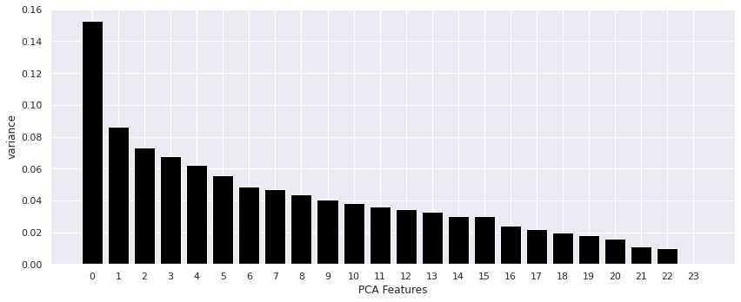
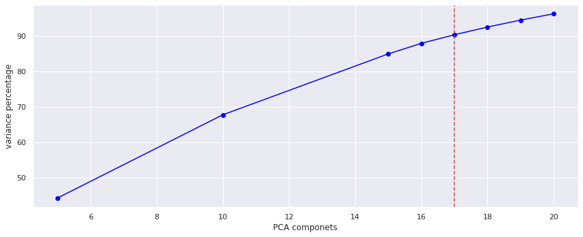
Results of PCA

Slide 10
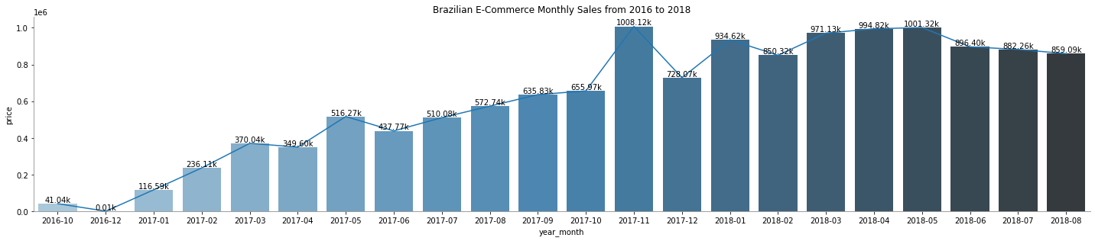
EDA
Let’s answer following questions by EDA:
Is there any effect on the sales based on particular days?
By observing the graph, We can see black Friday sale outperform every other month. Seems like slashing prices and giving discounts generate more revenue for the month.

Slide 11
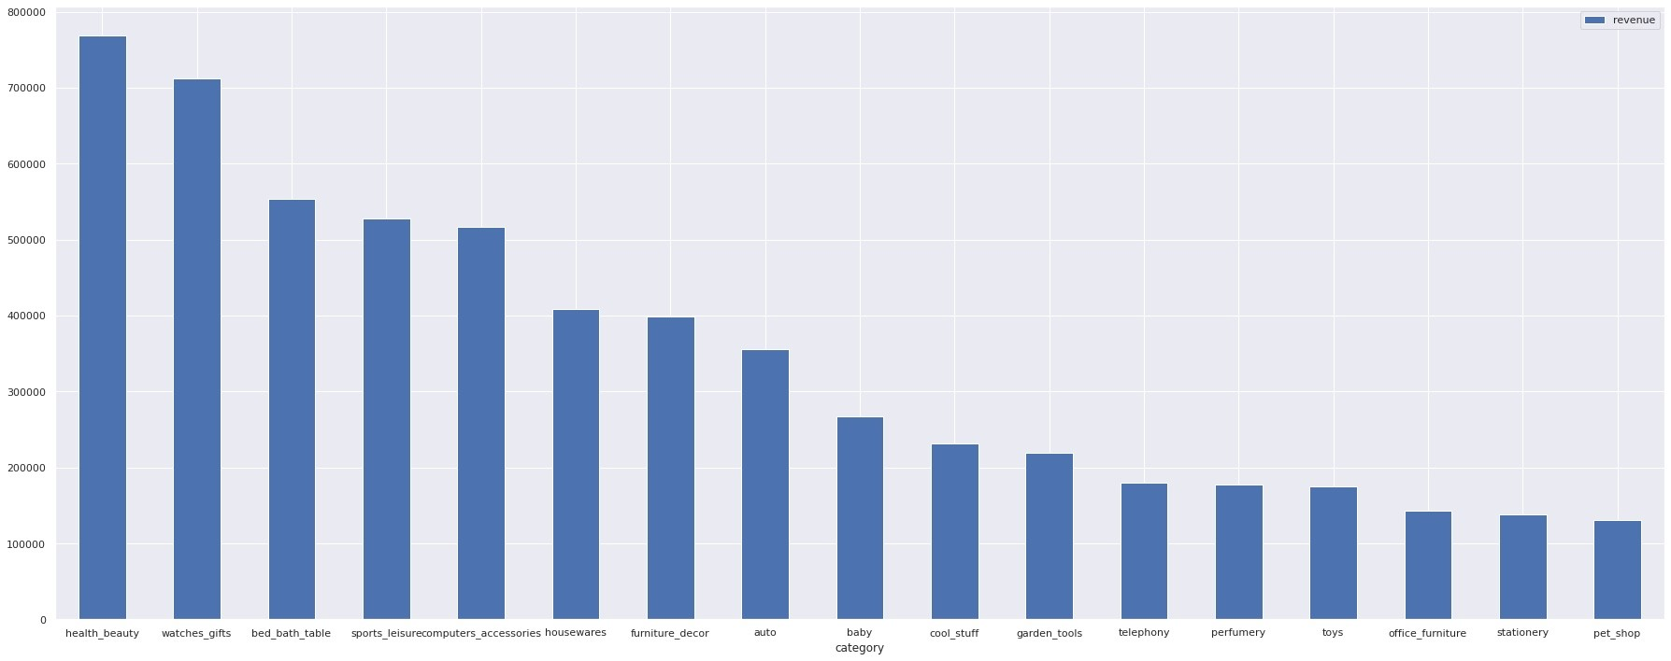
Which category generated most revenues in the year 2018?
By observing the graph, health and beauty generated the most revenue for the year.
Also, 80% revenue was generated by 17 categories.

Slide 12
Modeling
We implemented Linear regression to predict prices based on 17 features. Additionally, overcame the overfitting of data by applying regularization techniques like Ridge and Lasso.
Linear Regression RMSE: 2.795
Ridge Regression RMSE: 2.793
Lasso Regression RMSE: 2.73

Slide 13
Demand Curve
The demand curve is plotted for product from health beauty category.
As we increase the price, demand of product decreases.
Implemented linear regression on the price and sales quantity column of the filtered data.
Obtained maximum price by plotting sales quantity vs price graph.
It shows that if we optimize price to $39.84 of the product, more than 341 units are predicted to be sold.

Slide 14
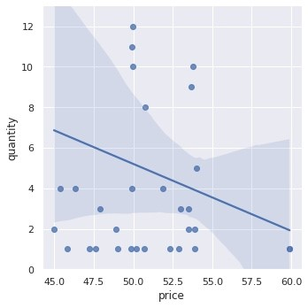
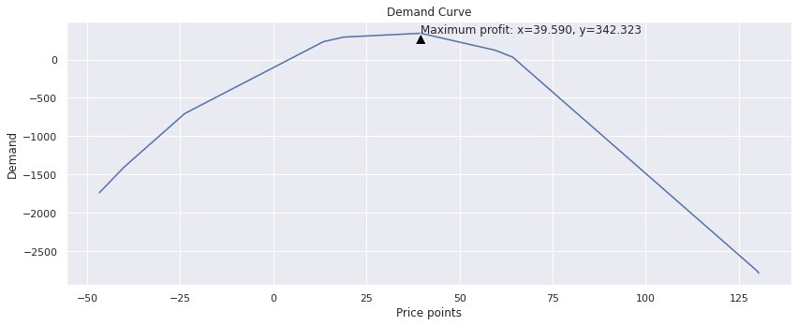
Results of Demand Curve

Slide 15
Conclusion
If the product’s demand increases by 45%, then revenue of product will be increased by ~78%.
Lasso gives better accuracy compared to Ridge and Linear regression.

Slide 16
Uniqueness
We attempted to boost the demand of product using optimizer based on frequent varying price range.
Calculated revenue margin percentage, based on predicted optimal price.

Slide 17
Future Scope
Compare orders and predict price region wise.
Analyze how customer reviews can impact selling of products.
Optimize delivery times by analyzing order approval time, order delivered carrier date, order reached to customer date
Predict products that would be purchased by customers in future comparing their past orders.

Slide 18
References
https://towardsdatascience.com/optimizing-product-price-using-regression-2c17688e65ea
https://medium.com/hamoye-blogs/unraveling-brazilian-e-commerce-dataset-e78463d77340
https://tryolabs.com/blog/price-optimization-machine-learning
https://arxiv.org/pdf/2007.05216v2.pdf
https://www.semanticscholar.org/paper/Price-Optimization-in-Fashion-E-commerce-Kedia-Jain/69d699ca6ac62c759c6372aa86a10756c8f509ce
https://arxiv.org/abs/2007.05216
https://7learnings.com/blog/price-optimization-with-machine-learning-what-every-retailer-should-know/

